Slide 1
A programmable modeling environment that can be used to simulate systems
NetLogo is agent-based modeling, which means the models involve telling agents (things in model) what to do
Developed by Center for Connected Learning and Computer-based Modeling, Northwestern University, Evanston, IL
Uri Wilensky https://ccl.northwestern.edu/netlogo/
Easy to use and free
Includes a large collection of simulations
It’s possible to program custom models

Slide 2
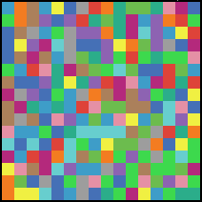
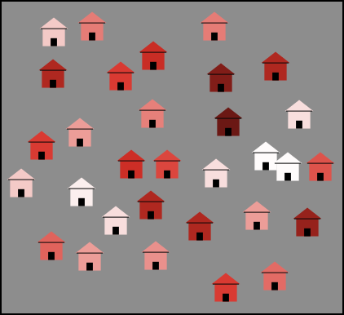
NetLogo Building Blocks
Two kinds of agents
Patches – Squares that fill 2- dimensional space. Patches can take on properties and store information, but cannot be moved
Turtles – Agents that move on top of patches, and can interact with each other and with patches. Agents include things like animals, cars, people, or water droplets

Slide 3
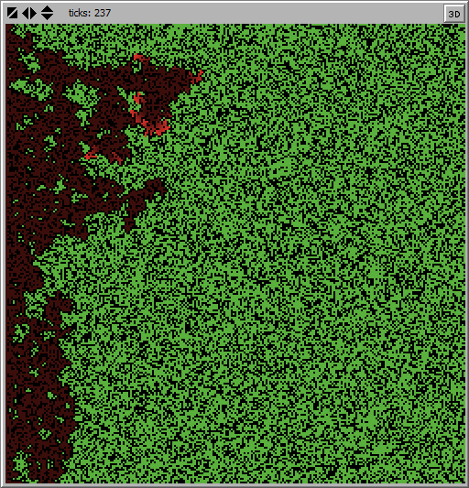
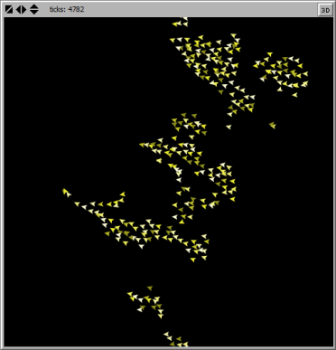
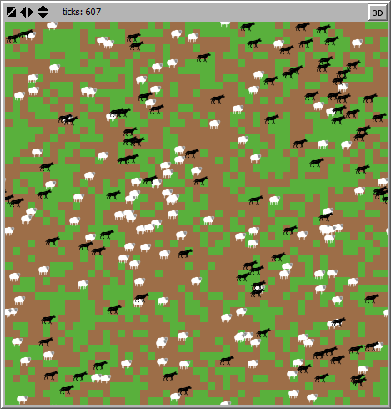
Three kinds of models in NetLogo
Patch only
Turtle only
Patch and turtle
Earth Science / Fire*
Biology / Flocking
Biology / Wolf Sheep Predation
* Models from the NetLogo model library provided with the software

Slide 4
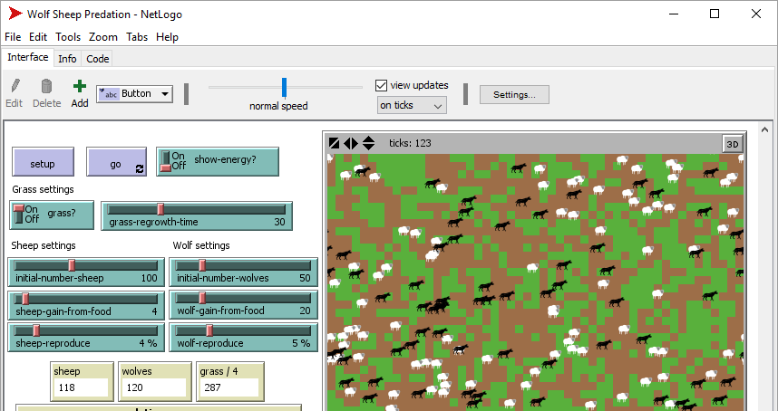
NetLogo Includes Interface, Info, & Code Tabs
Interface Tab
The view, or “graphical user interface,” that allows the model to be setup and run, and where results are displayed
Code
Tab
The computer code that makes the model work
Info Tab
A description of the model and its use

Slide 5
Graphical Interface Makes Running Models Easy
A ariety of controls and monitors …
Including buttons
Buttons can initialize, start, or stop a model, and may be “single action” …
Or they may have the “forever” icon, and repeat until pressed again
Sliders and switches
Sliders set a value between a minimum and maximum value
Switches set a true or false value or turn something on or off

Slide 6
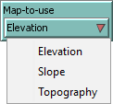
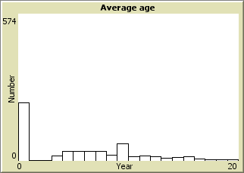
Graphical Interface Makes Running Models Easy
Choosers and Inputs
Set a value by selecting from options
Set a value directly
Monitors and Plots
Reports a value
Shows the history of a value as it changes
during a simulation, usually over time

Slide 7
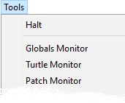
Graphical Interface Makes Running Models Easy
Other handy controls
Slow a simulation or speed
it up by updating the screen less
often (or not at all with “view
updates” unchecked)
Stop or “halt” a model that
doesn’t seem to be working
Enlarge or shrink the
graphical user interface

Slide 8
Programming in NetLogo
Coding in NetLogo is straightforward and a popular way to learn programming for elementary students to adults. For example:
Ask patches [ set pcolor green ] Make patches green
Ask cows [ forward 5 ] Move cows five patches forward
Ask cows with [ age < 1 ] [ forward 5 ] Move just calves five patches
Ask one-of cows [ hatch-cows 1 ] Make a random cow produce a calf
Ask cows with [ energy < 0 ] [ die ] Mortality of cows with too little energy
Ask cows [ eat-grass ] Have cows eat grass, coded in another
part of program called “eat-grass”
Ask n-of 5 patches Grow grass on five randomly selected
[ set grass grass + 5 ] patches
We won’t expand on programming now. You don’t need to program to use existing models. For now, editing code in a model may break it.

Slide 9
An Example Simulation - Ants
Let’s look at Ants (File -> Model library -> Biology -> Ants)
Author: Uri Wilensky (1997)
Read the material in the Info Tab …
In brief, simple agents representing ants search randomly
for food, and if they find it, produce chemicals that guide other ants.
Complex responses emerge.

Slide 10
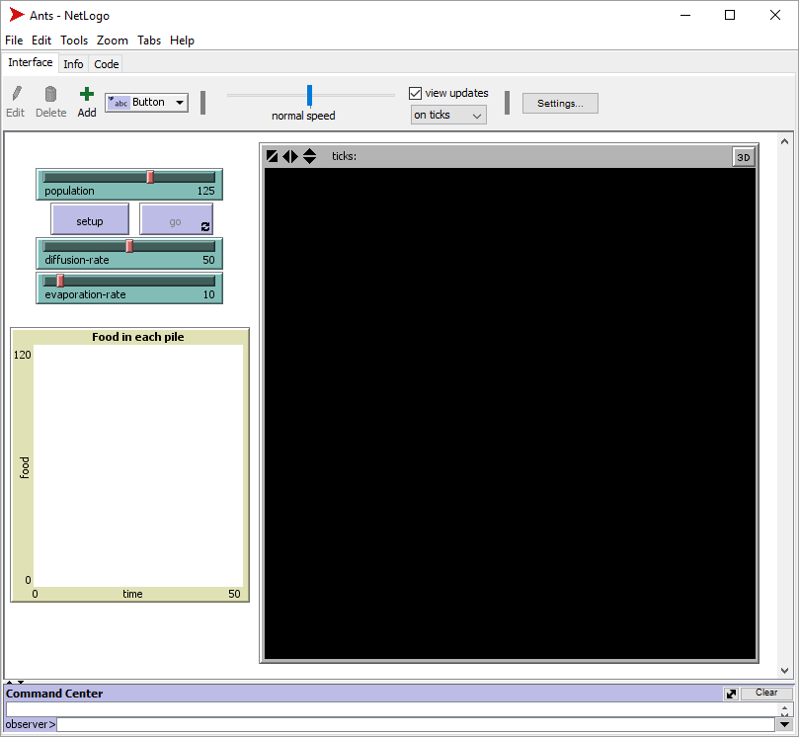
An Example Simulation – Ants
In this model, a colony of ants forages for food
Controls:
The number of ants
A button to setup the
model
A button to make the
model run
The rate of diffusion of
the chemicals produced
The rate of evaporation
of the chemicals produced
The model domain or space where the ants and food will occur
The amount of food remaining
In each pile

Slide 11
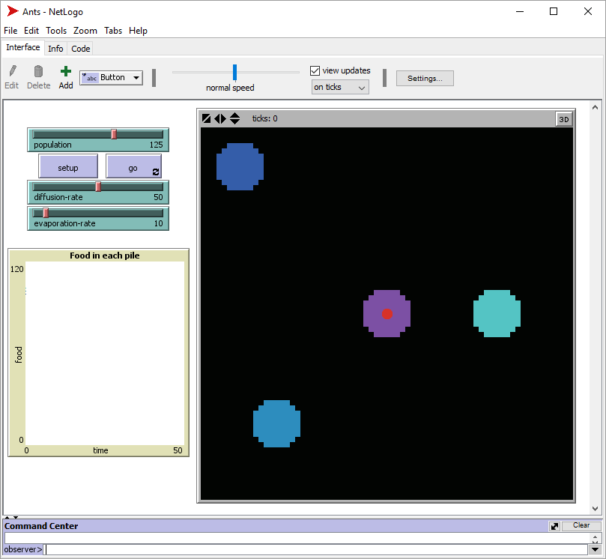
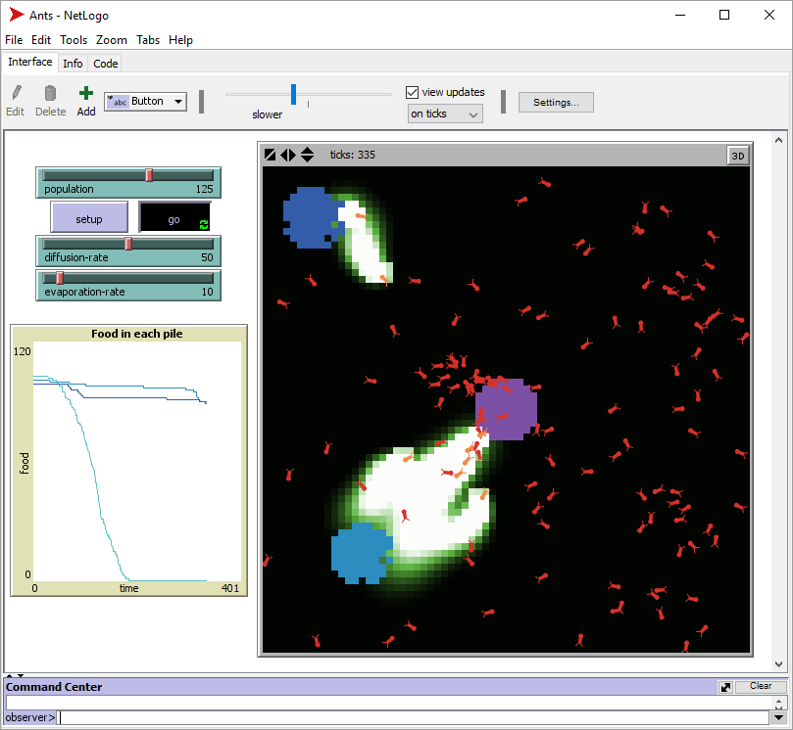
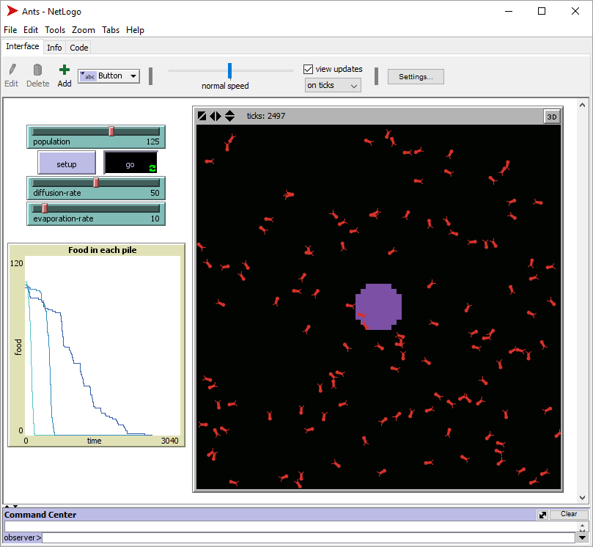
We can change the settings for population, diffusion and evaporation, and then run the model.
The speed and order in which the ants find the food differs depending on the settings (parameters).

Slide 12
What We’ll Do
We’ll use NetLogo models to simulate water (agent) moving across a surface water system (patches).

